Slide 1
Vehicle Accident Alert Solution

Slide 2
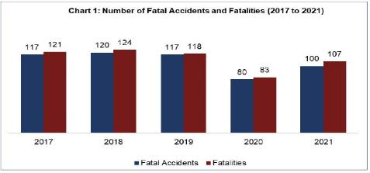
Background
Vehicle Accident Alert is a solution that sends an alerting message with the time and location of an accident transmitted automatically to emergency and relief organizations by a sensor placed in a vehicle. As a result, they will be able to respond quickly to the accident and assist the sufferer.
The main purpose of this project is to provide prompt aid and save lives by sending a location and alert message to the registered email address, phone number, and emergency numbers of the accident.
Chart of Singapore Fatal Accidents

Slide 3
Targeted Users
Emergency Providers
For this approach, the importance of an accident detection and reporting system is highly important. An accident is promptly notified to the emergency services in such a case. As a result, the accident victims who are injured will be immediately rescued.
Automakers
Although many individuals are working on this technology, it may have drawbacks due to poor results & a lack of funding. The automakers, who construct the automobiles, are ultimately responsible for improving their functional components and may incorporate a sensor that would produce better results.

Slide 4
Features
Cloud9 programming features include the random generation of automobile numbers, latitude and longitude to imitate real-time data transfer of an accident.
The email body of the SNS Topic Notification will include the location of the accident on Google Maps as well as the phone numbers of emergency providers such as the police and ambulance.
The S3 Bucket will be used as a storage location for written data in CSV format comprising accident details such as Car Number, Date, Latitude & Longitude.

Slide 5
Existing Products
Smartphone applications
Uses 4G to detect acceleration may cause false alarms since the object is a mobile device.
Smoke Detection System
A system that recognizes accidents also recognizes the state of the vehicle's engine and alerts the user if it detects flames or smoke. The system successfully keeps track of all anomalies, but it doesn't place a high focus on accident detection.
Internet of Things (IoT) Sensor
Using a IoT based automobile sensor will make use of a few parameters such as heart rate, speed & crash impact that are useful for accident detection and notification, sending the accident location to emergency services and families.
Notes:
Reference Cases : https://ijece.iaescore.com/index.php/IJECE/article/view/16079/13002

Slide 6
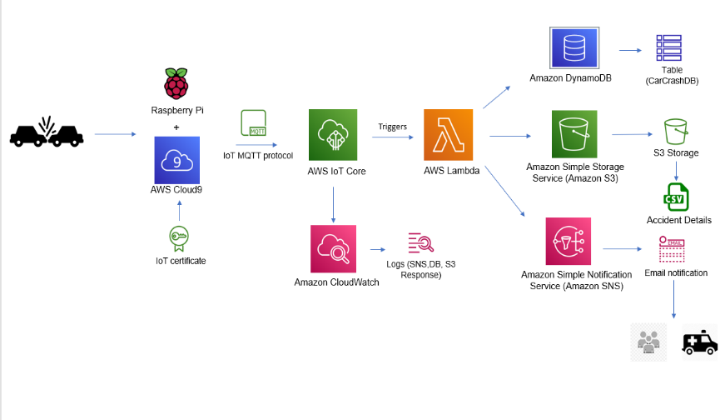

System Architecture

Slide 7

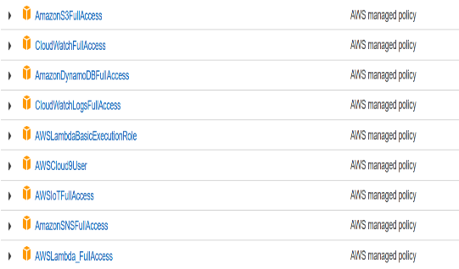
AWS service (IAM)
A new IAM user (carCrashUser) was created for this project. The user would be assigned the appropriate permissions and policies.

Slide 8
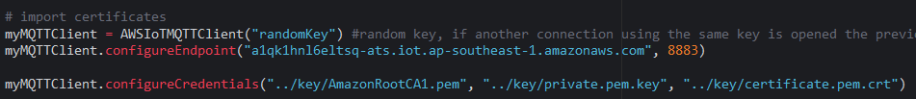

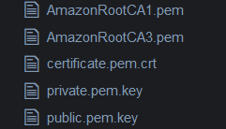
AWS service (Cloud9 & IoT Core)
For this project, AWS Cloud9 will use a cloud-based integrated development environment (IDE) to simulate the Raspberry Pi hardware. It will be utilized to launch and publish Real-Time Data Transfer to IOT Core through the topic “alert” & “speed” via MQTT Test Client Protocol.
AWS IoT Core will be used to connect to the Cloud9 service using the MQTT protocol, as authenticated by the IoT Things certificates and endpoints.

Slide 9
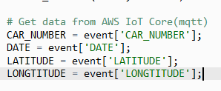
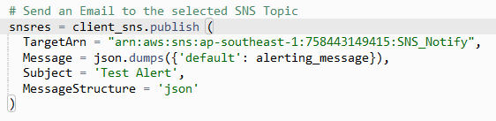
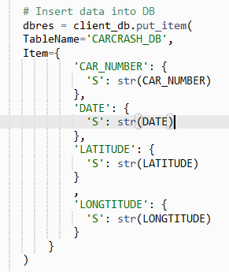
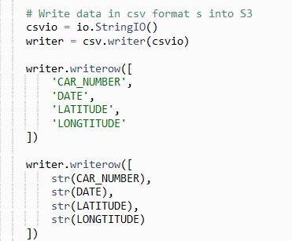
AWS service (Lambda)
The lambda function will be called in response to the IoT Core trigger by passing the accident information, such as the car number. Along from that, it will activate the function by sending an email notification to the required SNS topic and entering the data into the DynamoDB and S3 bucket.

Slide 10
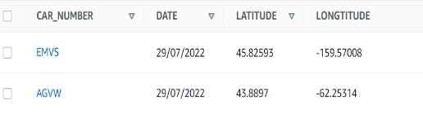
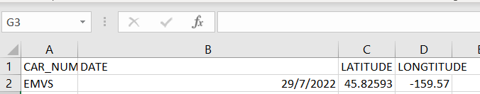
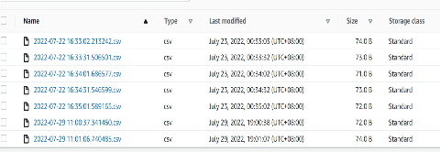
AWS service (DynamoDB & S3)
The lambda code would generate and use DynamoDB to store accident data such as the car number, date, latitude, and longitude. A S3 bucket is created to be a storage location for Amazon S3 items. A file in CSV containing accident information would also be stored in the s3 bucket triggered by the lambda function for this project.

Slide 11
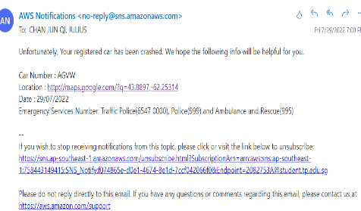
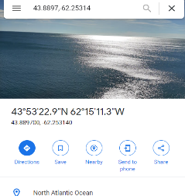
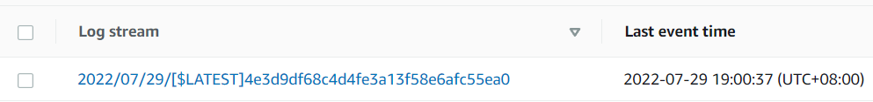
AWS service (SNS & CLOUDWATCH)
AWS SNS is used to send an involved party an email with the specifics of the accident and alerting drivers if they are going beyond the speed of 70/Hr. CloudWatch Logs makes it possible to view all the logs and make sure that the response is sent to the relevant services used for this project.

Slide 12
Assumptions
Assuming that the driver was engaged in fatal speed accident in actual scenario despite multiple notifications on speed limit.
The sensor identifies high speed limit and collision impact.
The IoT device receives input from the sensor and transmits the accident data.
Families and emergency service providers are promptly notified of the accident information such as Google Maps location, GPS coordinates of the area, and car number.
Emergency personnel would be able to respond quickly to the accident scene and assist the accident victim.

Slide 13
Limitations
In this project, the Raspberry PI will be used as a device simulator that is only compatible with a restricted number of sensors, such as a speed & Collison sensor. This may be practical; however, it is only considered in situations such as fatal speed accidents.
Since the MEMS & Accelerator sensor could only be used to detect crash impact & speed due to the solution's nature, only two IoT rules could be suggested and obeyed.

Slide 14
Future Enhancement
Instead of utilizing a device with a limited number of sensors, adding a few parameters such as vehicle acceleration, collision impact, and the value of a heart rate sensor (integrated into the belt), alcohol detection would significantly boost the possibility of detecting various types of accidents.
Building a notification algorithm and system that provides alerts based on vehicle behavior such as safety measures can also greatly help in accident prevention.

